Slide 1
Version Control

Slide 2
Agenda
What is version control
What is Git
How to use version control using Git
What is Github
How to use Github

Slide 3
What is Version Control ?
A version control system is a tool that manages changes made to the files and directories in a project
Version control record the changes made to your code overtime in a special database called repository or repo

Slide 4

Why Use a Version Control System ?
Generate backups
Team Collaboration
A side-effect of using a distributed version control is that it can act as a backup; every team member has a full-blown version of the project on his disk -
With a VCS, everybody on the team is able to work absolutely freely - on any file at any time. The VCS will later allow you to merge all the changes into a common version. There's no question where the latest version of a file or the whole project is. It's in a common, central place
Keep history and track changes
Test and experiment
Having a record of the changes in a specific code file could help you and new contributors understand how a specific part of the code came to be. How did it start and develop over time to reach its current version
When a team works on a software project, they often have different main project copy to develop new features on, test them, and make sure they function properly before this new feature can be added to the main project. This could save time as different aspects of the code can be developed simultaneously.
©2021 Proprietary and Confidential. All Rights Reserved.
4

Slide 5

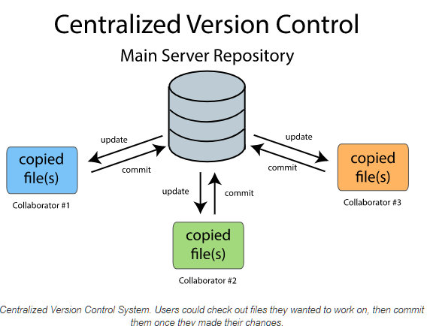
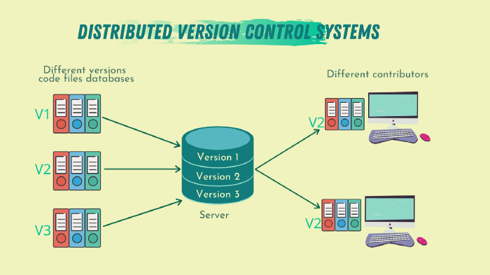
The various types of the version control systems are:
1. Local VCS
2. Centralized VCS
3. Distributed VCS
A local version control system is a local database located on your local computer, in which every file change is stored as a patch. Every patch set contains only the changes made to the file since its last version.
System with a single server containing all versions of the code files
Example : Subversion ,Team foundation server
one or more main server containing the code files.
Example: Git, Mercurial, or Bazaar
©2021 Proprietary and Confidential. All Rights Reserved.
5

Slide 6
Git
The most popular version-control system.
Git is free and open source distributed version control system designed to handle everything from small to very large projects with speed and efficiency.

Slide 7
Git strength
Nothing that is saved to Git is ever lost, so you can always go back to see which results were generated by which versions of your programs.
Git automatically notifies you when your work conflicts with someone else's, so it's harder (but not impossible) to accidentally overwrite work.
Git can synchronize work done by different people on different machines, so it scales as your team does.

Slide 8
How to use Git
1 Command line
2 Code editors and IDE (Pycharm and Vs code )
3 GUI (GitKraken , Sourcetree)

Slide 9
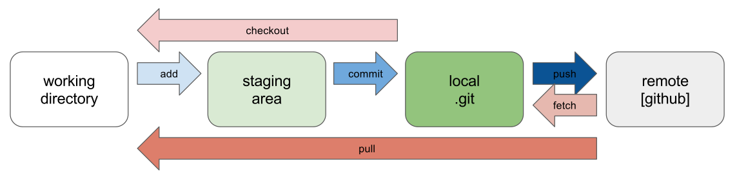
Git Workflow

Slide 10
GIT LAB / PRACTICAL
https://github.com/Heytec/ADS_REV_code/blob/main/03%20Lesson%20Version%20Control/03%20lesson%20Version%20Control%20(%20Git%20%26%20Github).ipynb
©2021 Proprietary and Confidential. All Rights Reserved.
10

Slide 11
Github
GitHub is a code hosting platform for version control and collaboration.
GitHub is a company founded in 2008 https://github.com/
Microsoft revealed earlier this 2018 that it's acquiring GitHub for $7.5 billion.
Github makes tools which integrate with git.
There are many other alternatives to GitHub, such as GitLab and BitBucket

Slide 12
What is the difference between Git and GitHub?
Git is a version control system that lets you manage and keep track of your source code history. GitHub is a cloud-based hosting service that lets you manage Git repositories. If you have open-source projects that use Git, then GitHub is designed to help you better manage them.

Slide 13
GIT LAB / PRACTICAL
https://github.com/Heytec/ADS_REV_code/blob/main/03%20Lesson%20Version%20Control/03%20lesson%20Version%20Control%20(%20Git%20%26%20Github).ipynb
©2021 Proprietary and Confidential. All Rights Reserved.
10

